Slide 1
Chapter 7
Arrays
Dai Liyun
dailiyun@swu.edu.cn

Slide 2
Chapter 7
7.1 INTRODUCTION TO ARRAYS
7.2 ARRAYS IN FUNCTIONS
7.3 PROGRAMMING WITH ARRAYS
7.4 MULTIDIMENSIONAL ARRAYS

Slide 3

7.1 INTRODUCTION TO ARRAYS Declaring and Referencing Arrays
int score[5];
score[0], score[1], score[2], score[3], score[4]ss
int next, score[5], max;
int n = 2;
score[n + 1] = 99;
Usage:
Usage:

Slide 4
Use for Loops with Arrays
for (i = 0; i < 5; i++)
cout << score[i] << " off by "
<< (max - score[i]) << endl;
（1）Array Indexes Always Start with Zero
（2）Array Index Out of Range
Note：

Slide 5
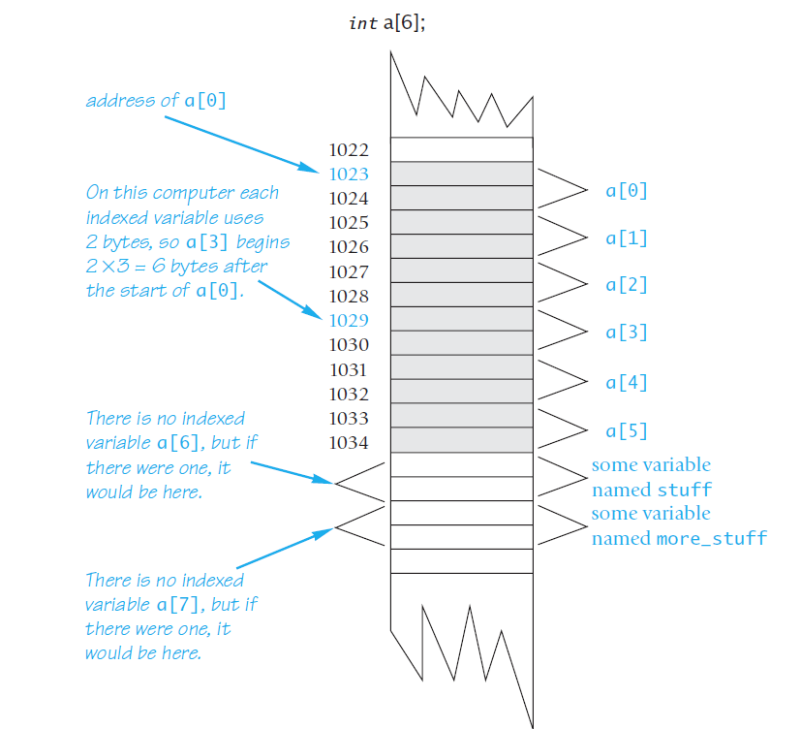
An Array in Memory

Slide 6
Initializing Arrays
For example,
int children[3] = {2, 12, 1};
This declaration is equivalent to the following code:
int children[3];
children[0] = 2;
children[1] = 12;
children[2] = 1;

Slide 7
Initializing Arrays
For example, the following declaration
int b[] = {5, 12, 11};
is equivalent to
int b[3] = {5, 12, 11};

